Slide 1
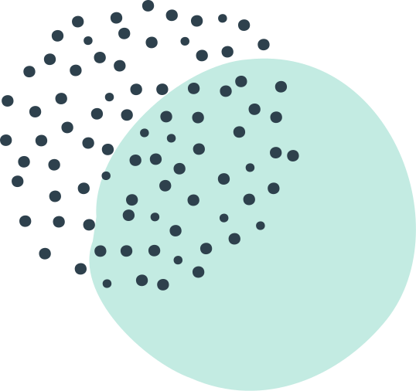
DSO 562
Fraud Analytics
Spring 2020
USC Marshall
Credit Card Transaction Fraud Analysis
Presentation by:
Aixuan Liu, Chao Wang, Cheng Shi,
Chengjun Liu, Minglu Chi, Shijie Xiang

Slide 2

Agenda
Executive Summary
Data Quality Report & Data Cleaning
Variable Creation
Feature Selection
Modeling
Results
Conclusion

Slide 3
Part 1 -
Executive
Summary

Slide 4
Business Problem:
Identify fraud credit card transaction
Data
Our Approach
Our Result
Credit card transaction of a Tennessee government agency in 2016
Build a supervised machine learning model to identify fraud in real-time
A model based on the Random Forest algorithm, XX% fraud detection rate (FDR) 3% on out-of-time data

Slide 5
Part 2 -
Data Quality &
Data Cleaning

Slide 6
Shape
AUDITORY
Presentations are communication tools.
Data Quality
READING
KINESTHETIC
Presentations are communication tools.
Presentations are communication tools.

Slide 7

The fraud behavior we are looking for
Presentations are communication tools that can be demonstrations, lectures, speeches, reports, and more.

Slide 8
Part 3 -
Variable
Creation

Slide 9
Part 4 -
Feature
Selection

Slide 10
Part 5 -
Modeling

Slide 11
Part 6 -
Results

Slide 12
Part 7 -
Conclusion

Slide 13

Mackenzie Anderson
EXPERIENCE
Presentations are communication tools that can be demonstrations
TEACHER AND RESEARCHER
CONTRIBUTIONS
Presentations are communication tools that can be demonstrations

Slide 14

What's essential for all millennials regardless
of their career?
MASTERING THE ART OF LEARNING
(AND HAVING FUN WITH IT!)

Slide 15
88%
THE EDUCATION REVOLUTION
OF SCHOOLS ARE EXPERIMENTING WITH NEW METHODS OF LEARNING

Slide 16
A 21st Century World
Presentations are communication tools that can be demonstrations, lectures, speeches, reports, and more.

Slide 17



WHERE DO MILLENNIALS THINK EDUCATION IS GOING?
ANDREA RAWAT
VICTORIA CANTU
EDOUARD BETT
Writer
Management Trainee
Youth Counselor
Presentations are communication tools.
Presentations are communication tools.
Presentations are communication tools.

Slide 18
Rise of
Self-Learning
40
30
Presentations are communication tools that can be demonstrations, lectures, and speeches.
20
10
0
Item 1
Item 2
Item 3
Item 4
Item 5

Slide 19
The Psychology Behind Learning
Presentations are communication tools that can be demonstrations and speeches.

Slide 20

Presentations are communication tools that can be lectures.
Fun Hacks | Marceline Anderson

Slide 21
VISUAL
AUDITORY
Presentations are communication tools.
Presentations are communication tools.
TYPE OF LEARNERS
READING
KINESTHETIC
Presentations are communication tools.
Presentations are communication tools.

Slide 22



LEARNING IN ACTION
Presentations are communication tools that can be demonstrations and speeches.

Slide 23
Helpful Resources
Presentations are communication tools that can be demonstrations.

Slide 24



Factors for Success
Motivation
Curiosity
Play

Slide 25

INDIVIDUAL LEARNING
Presentations are communication tools that can be demonstrations.
GROUP LEARNING
Presentations are communication tools that can be demonstrations.

Slide 26

Application
Fun Hacks | Marceline Anderson
HOW IT WORKS IN DAILY LIFE
Presentations are communication tools that
can be demonstrations and speeches.

Slide 27


GATHERING
The Process
Presentations are communication tools that can be demonstrations.
PROCESSING
Presentations are communication tools that can be demonstrations.
ASSIMILATING
Presentations are communication tools that can be demonstrations.

Slide 28

A 30-DAY CHALLENGE
Fun Hacks | Marceline Anderson
Presentations are communication tools that can be demonstrations, lectures, speeches, reports, and more.

Slide 29
UNCONSCIOUS INCOMPETENCE
Presentations are communication tools that can be demonstrations.
CONSCIOUS INCOMPETENCE
Presentations are communication tools that can be demonstrations.
Five Stages of Learning
CONSCIOUS COMPETENCE
Presentations are communication tools that can be demonstrations.

Slide 30
MILLENNIAL PREFERENCES
Most Popular Methods
75
50
25
Presentations are communication tools that can be demonstrations, lectures, speeches, reports, and more.
0
Item 1
Item 2
Item 3
Item 4

Slide 31

Learning Trends
ONLINE COURSES
Presentations are communication tools.
GAMIFICATION
Presentations are communication tools.
SOCIAL LEARNING
Presentations are communication tools.

Slide 32
900%
GROWTH OF ONLINE LEARNING OVER THE PAST 15 YEARS
$7.3 billion
VALUE OF GLOBAL GAMIFICATION MARKET

Slide 33
Top Skills for Today
DIGITAL
INTERPERSONAL
PROBLEM-SOLVING
Presentations are communication tools that can be demonstrations.
Presentations are communication tools that can be demonstrations.
Presentations are communication tools that can be demonstrations.

Slide 34
GREATER HAPPINESS
CAREER SECURITY
IMPROVED
SKILLS
Presentations are communication tools that can be demonstrations.
Presentations are communication tools that can be demonstrations.
Presentations are communication tools that can be demonstrations.
CREATIVITY AND INNOVATION
BETTER OPPORTUNITIES
BETTER BRAIN HEALTH
Presentations are communication tools that can be demonstrations.
Presentations are communication tools that can be demonstrations.
Presentations are communication tools that can be demonstrations.

Slide 35
ALWAYS WALK THROUGH LIFE AS IF YOU HAVE SOMETHING NEW TO LEARN.
FINAL WORDS
VERNON HOWARD

